Slide 1
Software Process Models

Slide 2
The software process
A structured set of activities required to develop a
software system
  Specification;
  Design;
  Validation;
  Evolution.
A software process model is an abstract representation of a process. It presents a description of a process from some particular perspective.

Slide 3
Generic software process models
The waterfall model
  Separate and distinct phases of specification and development.
Evolutionary development
  Specification, development and validation are interleaved.
Component-based software engineering
  The system is assembled from existing components.
There are many variants of these models e.g. formal development where a waterfall-like process is used but the specification is a formal specification that is refined through several stages to an implementable design.

Slide 4
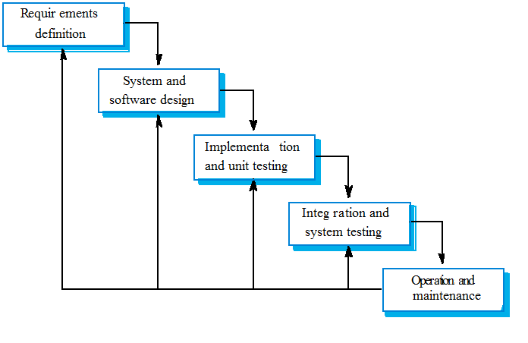
Waterfall model

Slide 5
Waterfall model phases
Requirements analysis and definition
System and software design
Implementation and unit testing (Coding)
Integration and system testing (Deployment)
Operation and maintenance
One phase has to be complete before moving onto the next phase.

Slide 6
Waterfall model applications
Some situations where the use of Waterfall model is most appropriate are −
Requirements are very well documented, clear and fixed.
Product definition is stable.
Technology is understood and is not dynamic.
There are no ambiguous requirements.
Ample resources with required expertise are available to support the product.
The project is short.

Slide 7
Waterfall model advantages
Some of the major advantages of the Waterfall Model are as follows −
Simple and easy to understand and use
Easy to manage due to the rigidity of the model. Each phase has specific deliverables and a review process.
Phases are processed and completed one at a time.
Works well for smaller projects where requirements are very well understood.
Clearly defined stages.
Well understood milestones.
Easy to arrange tasks.
Process and results are well documented.

Slide 8
Waterfall model problems
Inflexible partitioning of distinct phases makes it difficult to respond to changing customer requirements.
  Therefore, this model is only appropriate when the requirements are well-understood and changes will be fairly limited during the design process. But, in reality, only a Few business systems have stable requirements.
No working software is produced until the final stage of the life cycle.
High amounts of risk and uncertainty.
Not a good model for complex and object-oriented projects.
Poor model for long and ongoing projects.

Slide 9
Evolutionary development
Exploratory development
  More like an experimental development. New to the world or new to the developing company.
  Result of the development maybe not be as expected, thus, may need to leave it and go some other way.
Throw-away prototyping
  Objective is to understand the system requirements. Should start with poorly understood requirements to clarify what is really needed.

Slide 10
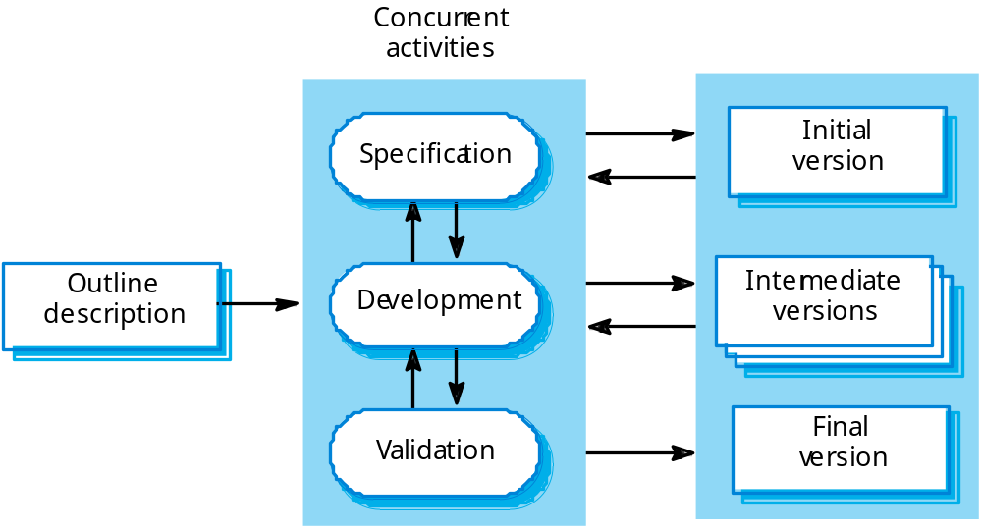
Evolutionary development

Slide 11
Evolutionary development
Problems
  Lack of process visibility;
  Systems are often poorly structured;
  Special skills (e.g. in languages for rapid prototyping) may be required.
Applicability
  For small or medium-size interactive systems;
  For parts of large systems (e.g. the user interface);
  For short-lifetime systems.

Slide 12
Reuse-oriented development
Based on systematic reuse where systems are integrated from existing components or COTS (Commercial-off-the-shelf) products not developed as a Bespoke system.
Process stages
  Component analysis;
  Requirements modification;
  System design with reuse;
  Development and integration.
This approach is becoming increasingly used as component standards have emerged.

Slide 13
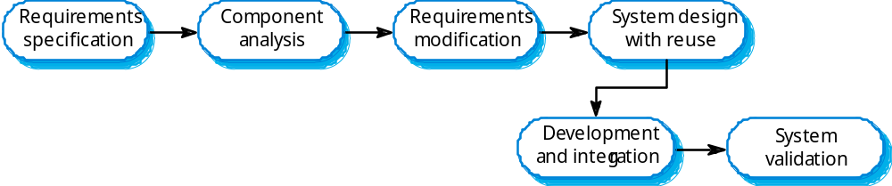
Reuse-oriented development

Slide 14
Side-note: COTS Product
Short for Commercial Off-The-Shelf, an adjective that describes software or hardware products that are ready-made and available for sale to the general public. For example, Microsoft Office is a COTS product that is a packaged software solution for businesses. COTS products are designed to be implemented easily into existing systems without the need for customization.
Courtesy: http://www.webopedia.com/TERM/C/COTS.html

Slide 15
Side-note: Bespoke system
Bespoke software is custom or tailor-made software. The value of bespoke software over off-the-shelf software is that it can be designed specifically for key business or legislative objectives.
Courtesy: https://www.techopedia.com/definition/6184/bespoke-software

Slide 16
Process iteration
System requirements ALWAYS evolve in the course of a project so process iteration where earlier stages are reworked is always part of the process for large systems.
Iteration can be applied to any of the generic process models.
Two (related) approaches
  Incremental delivery;
  Spiral development.

Slide 17
Incremental delivery
Rather than deliver the system as a single delivery, the development and delivery is broken down into increments with each increment delivering part of the required functionality.
User requirements are prioritised and the highest priority requirements are included in early increments.
Once the development of an increment is started, the requirements are frozen though requirements for later increments can continue to evolve.

Slide 18
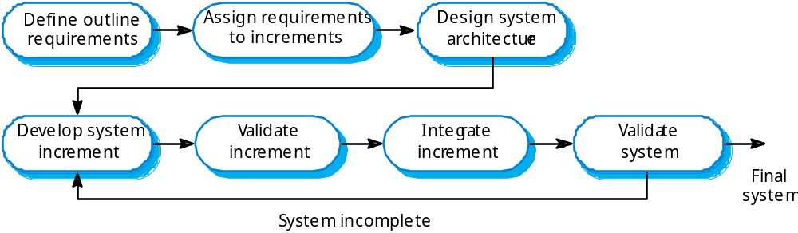
Incremental development

Slide 19
Incremental development advantages
Customer value can be delivered with each increment so system functionality is available earlier.
Early increments act as a prototype to help elicit requirements for later increments.
Lower risk of overall project failure.
The highest priority system services tend to receive the most testing.

Slide 20
Agile Software Development
There are a variety of Agile software development (or system development) methodologies, including, but not limited to:
Disciplined Agile Delivery (DAD)
Adaptive Software Development
Agile Modeling
Kanban
Scrum
Scrumban
Extreme Programming (XP)
Dynamic Systems Development (DSDM)
Feature Driven Development
Lean Software Development

Slide 21
Agile Principles (Summary)
Individuals and Interactions Over Processes and Tools
  Communication happens when a need arises
Working Software Over Comprehensive Documentation
  Documents requirements as user stories
Customer Collaboration Over Contract Negotiation
  Customer is engaged and collaborates throughout the development process
Responding to Change Over Following a Plan
  Priorities can be shifted from iteration to iteration and new features can be added into the next iteration.

Slide 22
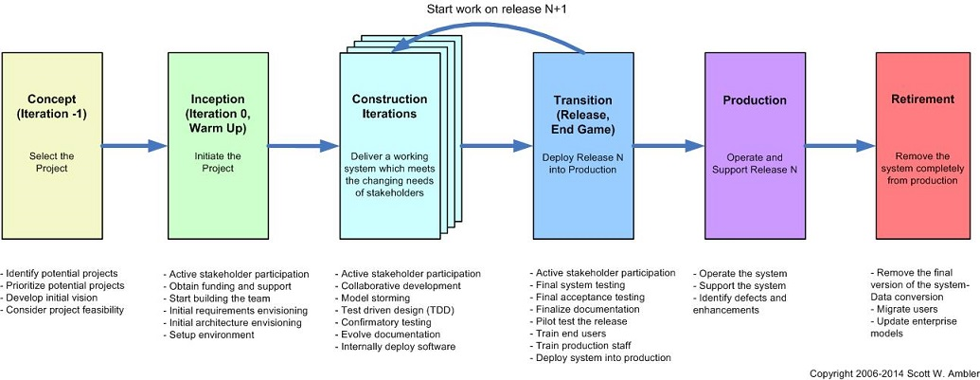

Slide 23
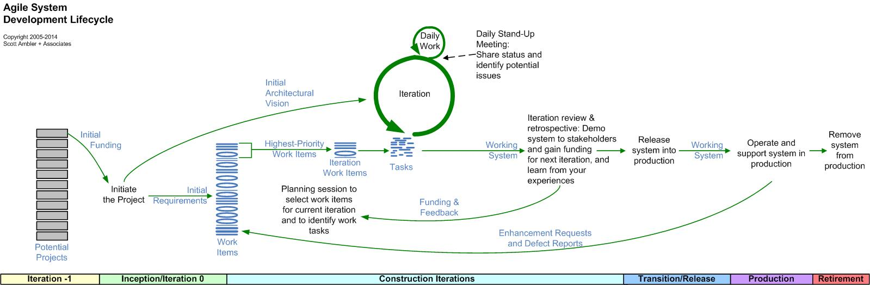
Please use the image source:
http://www.ambysoft.com/essays/agileLifecycle.html

Slide 24
Extreme programming
An approach to development based on the development and delivery of very small increments of functionality.
Programming in pairs
Test driven development
Continuous planning, change , delivery
Shared project metaphors, coding standards and ownership of code

Slide 25
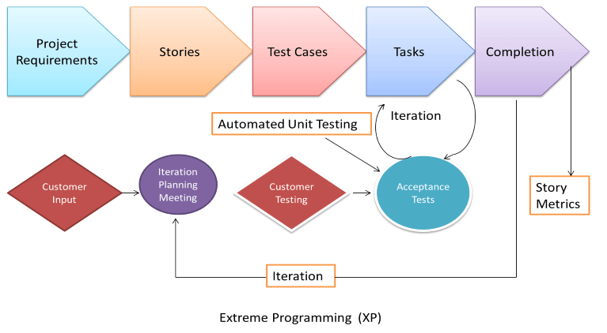
Extreme programming

Slide 26
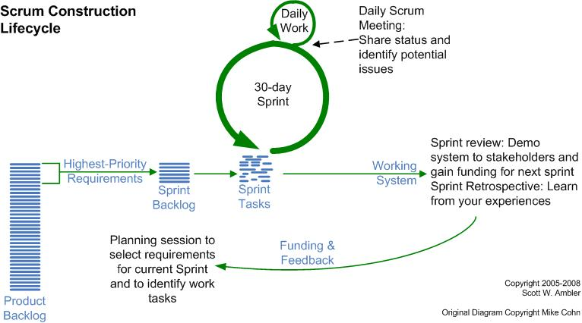
SCRUM
https://www.scrumalliance.org/community/articles/2007/march/glossary-of-scrum-terms

Slide 27
Difference between SCRUM and XP
There are four main differences between Scrum and XP:
Scrum teams typically work in iterations (called sprints) that are from two weeks to one month long. XP teams typically work in iterations that are one or two weeks long.
Scrum teams do not allow changes into their sprints. Once the sprint planning meeting is completed and a commitment made to delivering a set of product backlog items, that set of items remains unchanged through the end of the sprint.
XP teams are much more amenable to change within their iterations. As long as the team hasn’t started work on a particular feature, a new feature of equivalent size can be swapped into the XP team’s iteration in exchange for the unstarted feature.

Slide 28
Extreme Programming teams work in a strict priority order. Features to be developed are prioritized by the customer (Scrum’s Product Owner) and the team is required to work on them in that order.
By contrast, the Scrum product owner prioritizes the product backlog but the team determines the sequence in which they will develop the backlog items.
[However, at some point one of the high priority items may not be a good fit for the sprint being planned—maybe a key person who should work on it will be swamped by work on higher priority items. Or maybe it makes sense to work on a slightly lower priority item (let’s say #10 on the product backlog instead of #6) because the team will be working in the code where #10 would be implemented.]

Slide 29
Scrum doesn’t prescribe any engineering practices; XP does, particularly things like test-driven development, the focus on automated testing, pair programming, simple design and refactoring.
  [However, I think it’s a mistake to say to the team “you're self-organizing, we trust you, but you must do these specific engineering practices….” This sends a mixed message to the team that causes confusion. I love the XP practices but don’t like mandating them. I want teams to discover the value on their own.]

Slide 30
XP and change
Conventional wisdom in software engineering is to design for change. It is worth spending time and effort anticipating changes as this reduces costs later in the life cycle.
XP, however, maintains that this is not worthwhile as changes cannot be reliably anticipated.
Rather, it proposes constant code improvement (refactoring) to make changes easier when they have to be implemented.

Slide 31
Refactoring
Programming team look for possible software improvements and make these improvements even where there is no immediate need for them.
This improves the understandability of the software and so reduces the need for documentation.
Changes are easier to make because the code is well-structured and clear.
However, some changes requires architecture refactoring and this is much more expensive.

Slide 32
Examples of refactoring
Re-organization of a class hierarchy to remove duplicate code.
Tidying up and renaming attributes and methods to make them easier to understand.
The replacement of inline code with calls to methods that have been included in a program library.

Slide 33
Pair programming
In XP, programmers work in pairs, sitting together to develop code.
This helps develop common ownership of code and spreads knowledge across the team.
It serves as an informal review process as each line of code is looked at by more than 1 person.
It encourages refactoring as the whole team can benefit from this.
Measurements suggest that development productivity with pair programming is similar to that of two people working independently.

Slide 34
Pair programming
In pair programming, programmers sit together at the same workstation to develop the software.
Pairs are created dynamically so that all team members work with each other during the development process.
The sharing of knowledge that happens during pair programming is very important as it reduces the overall risks to a project when team members leave.
Pair programming is not necessarily inefficient and there is evidence that a pair working together is more efficient than 2 programmers working separately.
Chapter 3 Agile software development

Slide 35
Advantages of pair programming
It supports the idea of collective ownership and responsibility for the system.
  Individuals are not held responsible for problems with the code. Instead, the team has collective responsibility for resolving these problems.
It acts as an informal review process because each line of code is looked at by at least two people.
It helps support refactoring, which is a process of software improvement.
  Where pair programming and collective ownership are used, others benefit immediately from the refactoring so they are likely to support the process.
Chapter 3 Agile software development

Slide 36
Advantages of XP and SCRUM
Lightweight methods suit small-medium size projects
Produces good team cohesion
Emphasises final product
Iterative
Test based approach to requirements and quality assurance

Slide 37
Disadvantages
Difficult to scale up to large projects where documentation is essential
Needs experience and skill if not to degenerate into code-and-fix
Programming pairs is costly
Test case construction is a difficult and specialised skill.

Slide 38
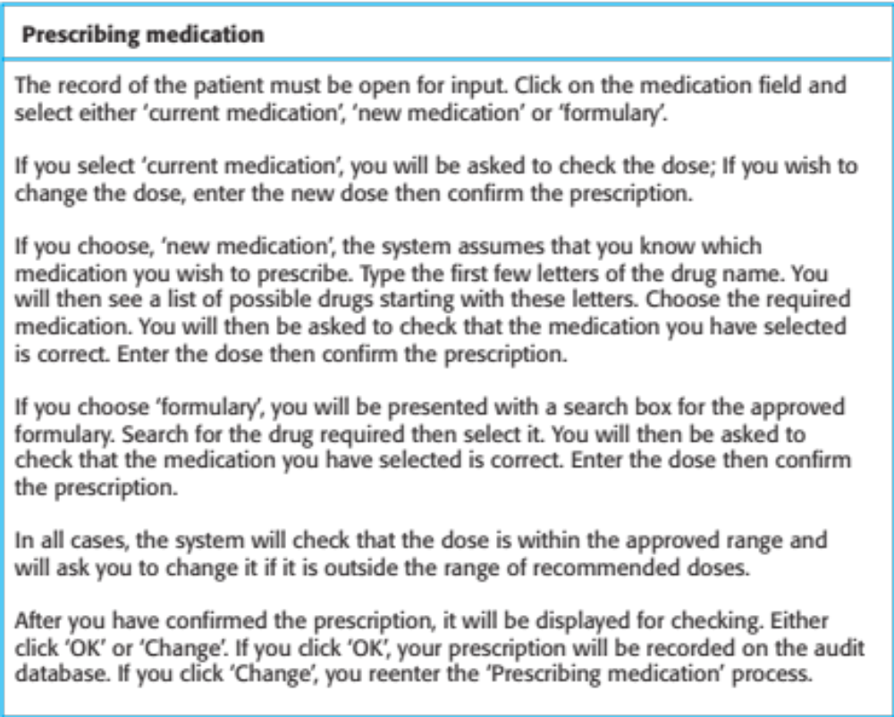
A ‘prescribing medication’ story

Slide 39
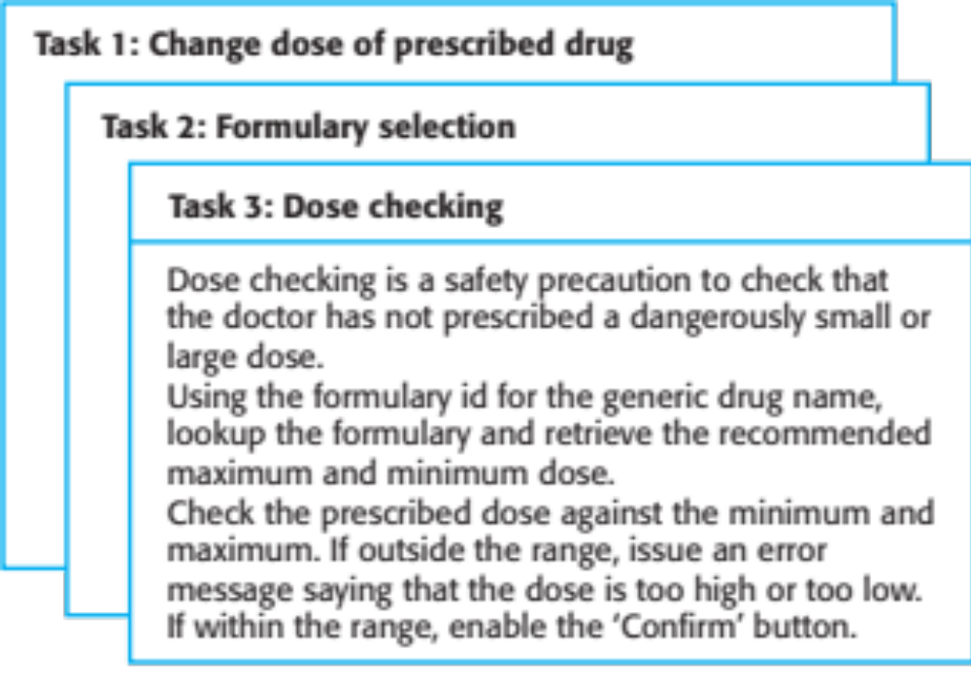
Examples of task cards for prescribing medication

Slide 40
Spiral development
Process is represented as a spiral rather than as a sequence of activities with backtracking.
Each loop in the spiral represents a phase in the process.
No fixed phases such as specification or design - loops in the spiral are chosen depending on what is required.
Risks are explicitly assessed and resolved throughout the process.

Slide 41
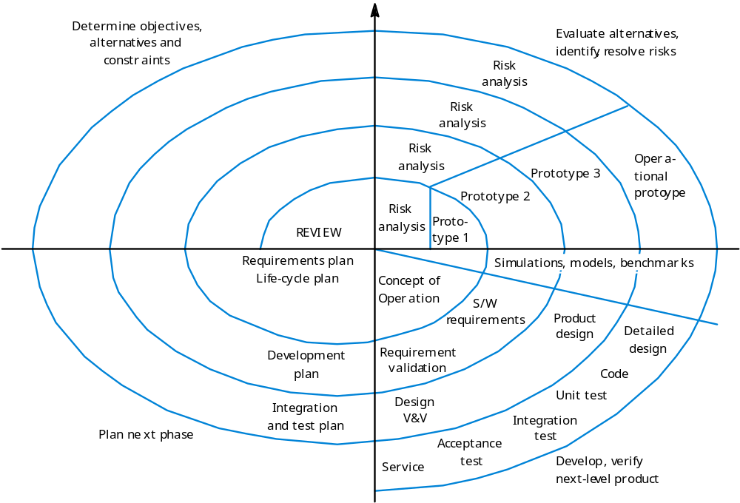
Spiral model of the software process

Slide 42
Spiral model sectors
Objective setting
  Specific objectives for the phase are identified.
Risk assessment and reduction
  Risks are assessed and activities put in place to reduce the key risks.
Development and validation
  A development model for the system is chosen which can be any of the generic models.
Planning
  The project is reviewed and the next phase of the spiral is planned.

Slide 43
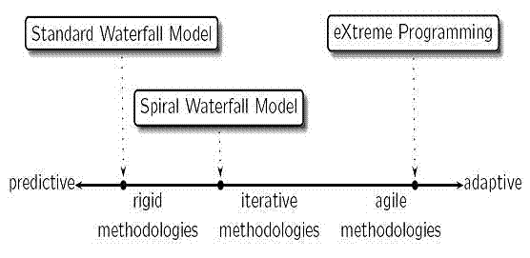

Slide 44
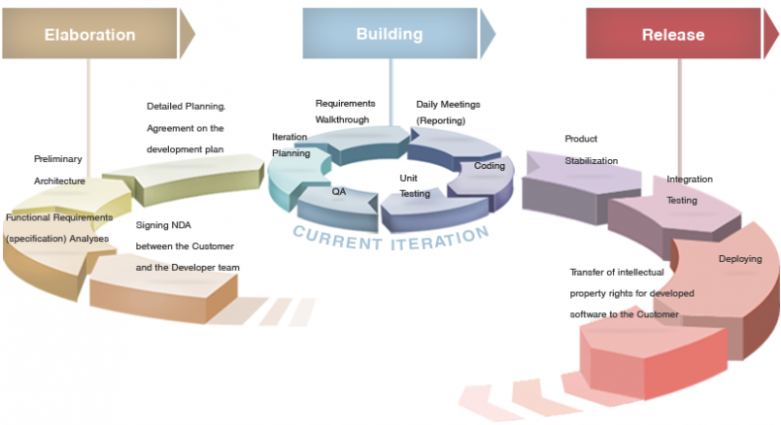
Example of a Real Context
http://innowise-group.com/processes/organizational-model

Slide 45
Term | Definition
Team Backlog | A prioritized list of high level requirements. This list is a 'living document' that ebbs and flows over time as stories are added, completed and should be monitored by the Product Owner (PO) / Team Lead.
Sprint | A time period (typically 2–4 weeks) in which work occurs on a set of backlog items that the Team has committed.
Sprint Backlog | A prioritized list of tasks to be completed during the sprint.
Epic | A large effort split up into multiple related user stories. If you have a very big project, it might be an 'Epic' that extends across various sprints, but each Epic should be broken down into manageable chunks.
User Story | A detailed description of a task with the stakeholders in mind. See the agile presentation for the 'anatomy' of a proper user story.
Sprint Burn Down | Daily progress chart for a Sprint over the sprint’s length. Not included in this spreadsheet and not a 'must have', but a nice visual representation of progress.

Slide 46
Thank you!!

